Slide 1
Superintendent Search
Staff Survey Results

Slide 2
Questions
Number of surveys sent: 4,200 (approximate)
Number or responses: 533
What do you feel is the most appropriate educational background for candidates for superintendent?
What are the most essential prior work experiences for a superintendent?
What are the most important skills a superintendent should possess?
What is the optimal attitude/disposition that a superintendent should have?

Slide 3
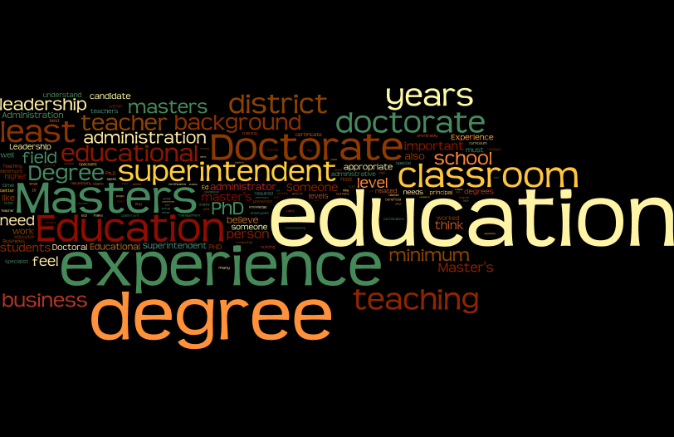
What do you feel is the most appropriate educational background for candidates for superintendent?

Slide 4
Word | Occurrences | Frequency | Rank
education | 187 | 8.3% | 1
masters | 111 | 4.9% | 2
experience | 105 | 4.7% | 3
doctorate | 101 | 4.5% | 4
classroom | 67 | 3% | 5
superintendent | 66 | 2.9% | 6
educational | 59 | 2.6% | 7
teaching | 54 | 2.4% | 8
district | 51 | 2.3% | 9
teacher | 41 | 1.8% | 10

Slide 5
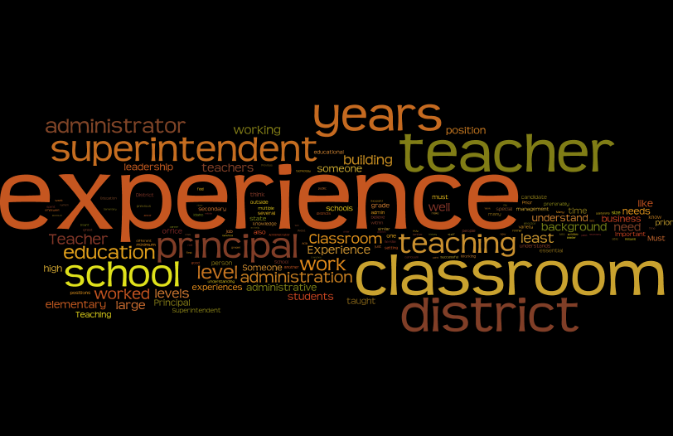
What are the most essential prior work experiences for a superintendent?

Slide 6
Word | Occurrences | Frequency | Rank
experience | 259 | 8.6% | 1
classroom | 193 | 6.4% | 2
teacher | 177 | 5.9% | 3
district | 135 | 4.5% | 4
superintendent | 108 | 3.6% | 5
principal | 99 | 3.3% | 6
teaching | 97 | 3.2% | 7
education | 54 | 1.8% | 8
administrator | 53 | 1.8% | 8
someone | 49 | 1.6% | 9

Slide 7
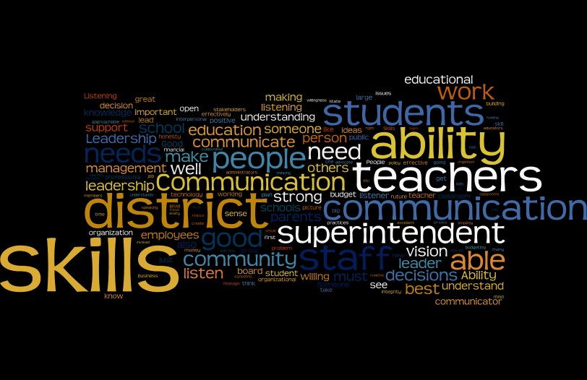
What are the most important skills a superintendent should possess?

Slide 8
Word | Occurrences | Frequency | Rank
ability | 143 | 3.7% | 1
communication | 138 | 3.6% | 2
district | 125 | 3.3% | 3
teachers | 101 | 2.6% | 4
students | 87 | 2.3% | 5
superintendent | 78 | 2% | 6
leadership | 66 | 1.7% | 7
community | 48 | 1.3% | 8
someone | 48 | 1.3% | 8
listening | 43 | 1.1% | 9

Slide 9
What is the optimal attitude/disposition that a superintendent should have?

Slide 10
Word | Occurrences | Frequency | Rank
teachers | 141 | 4.1% | 1
students | 124 | 3.6% | 2
district | 122 | 3.5% | 3
positive | 95 | 2.8% | 4
someone | 84 | 2.4% | 5
superintendent | 78 | 2.3% | 6
attitude | 56 | 1.6% | 7
willing | 52 | 1.5% | 8
approachable | 42 | 1.2% | 9
schools | 38 | 1.1% | 10

Slide 11
Conclusions
What do you feel is the most appropriate educational background for candidates for superintendent?
Educational Specialist (Superintendency)
Master’s Degree (preferred)
Doctorate (preferred)
What are the most essential prior work experiences for a superintendent?
Classroom Teacher
Principal
Superintendent
What are the most important skills a superintendent should possess?
Understanding of teaching/teachers
Communication
Superintendent
Leadership
What is the optimal attitude/disposition that a superintendent should have?
Understanding of teachers and teaching
Understanding of student needs
Understanding of district operations

